Slide 1

C Programming Project Presentation
Project Title: String Utility Box
Course: Mini Project
Student Name & Roll No: 1)Janarthanan.M.S-25bcs121
2)Janavathsha.B.V-25bcs122
3)Joy Priya.R-25bcs123
4)Karthiga Devi.D-25bcs124
5)Kashini.K-25bcs125
Department: Computer Science
Mentor / Guide: [Name & Designation]

Slide 2
Introduction
C Programming Project Presentation
The String Utility Box is a tool designed to perform various string operations such as counting characters, reversing text, changing case, and checking palindromes. It was developed to simplify the common and time-consuming tasks of string manipulation often required in programming and data analysis. By providing multiple string functions in one place, the project helps users process text efficiently, save time, and improve accuracy in real-world applications.

Slide 3
Objective
C Programming Project Presentation
The main objective of the String Utility Box project is to design and implement a C-based program that automates various string manipulation tasks. It aims to apply core programming logic and modular design principles to create an efficient, user-friendly tool for handling text operations. Additionally, the project seeks to demonstrate problem-solving and analytical skills by developing practical solutions for common string processing challenges.

Slide 4
Problem Statement
C Programming Project Presentation
Describe the current issue or gap in existing systems
Identify limitations or inefficiencies
Define how your project aims to address these challenges

Slide 5
System Requirements
C Programming Project Presentation
Hardware Requirements:
1)Processor: Intel Core i3 or higher
2)RAM: Minimum 4 GB
3)Storage: At least 500 MB of free space
Software Requirements:
1)Operating System: Windows or Linux
2)Compiler/IDE: GCC, Turbo C, Code::Blocks, or Dev C++

Slide 6
System Design
C Programming Project Presentation
The String Utility Box follows a simple modular structure divided into three main parts: Input, Processing, and Output.

Slide 7
Module Description
C Programming Project Presentation
1. Input Module:Takes user input such as the string and the selected operation (e.g., count characters, reverse, check palindrome).
2. Processing Module:Performs the required string operation using logic or functions based on user selection.
3. Output Module:Displays the result of the operation to the user on the screen.
4. File Handling Module:Saves processed data or results into a file and allows retrieval of previous operations when needed.

Slide 8
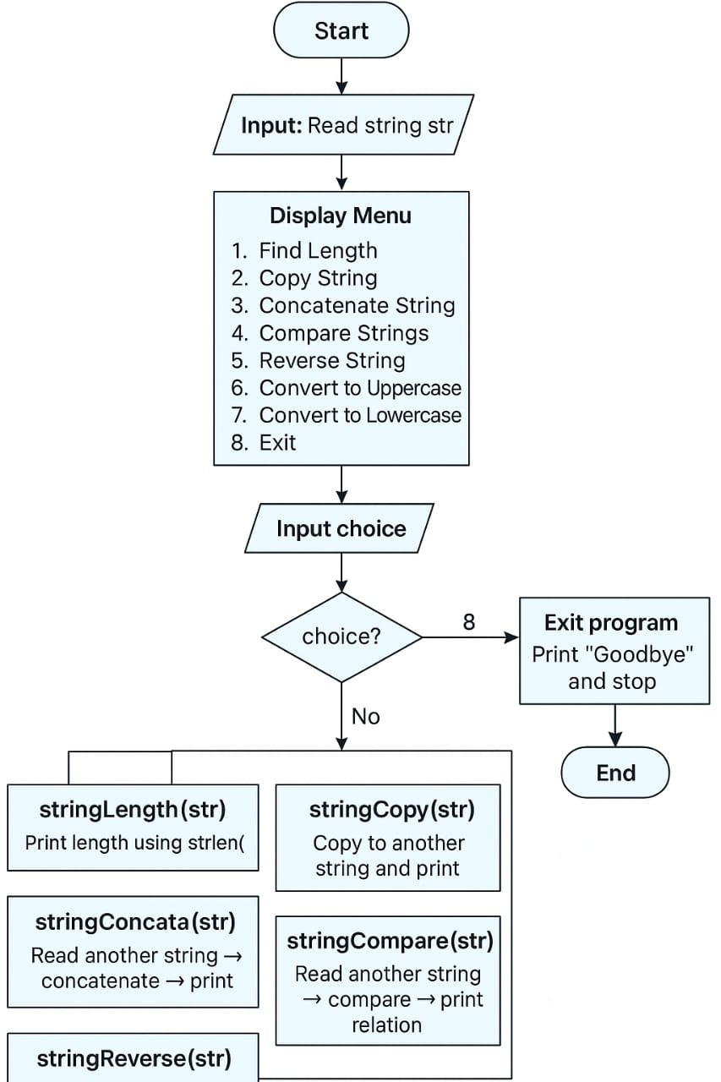
Algorithm / Flowchart
C Programming Project Presentation

Slide 9
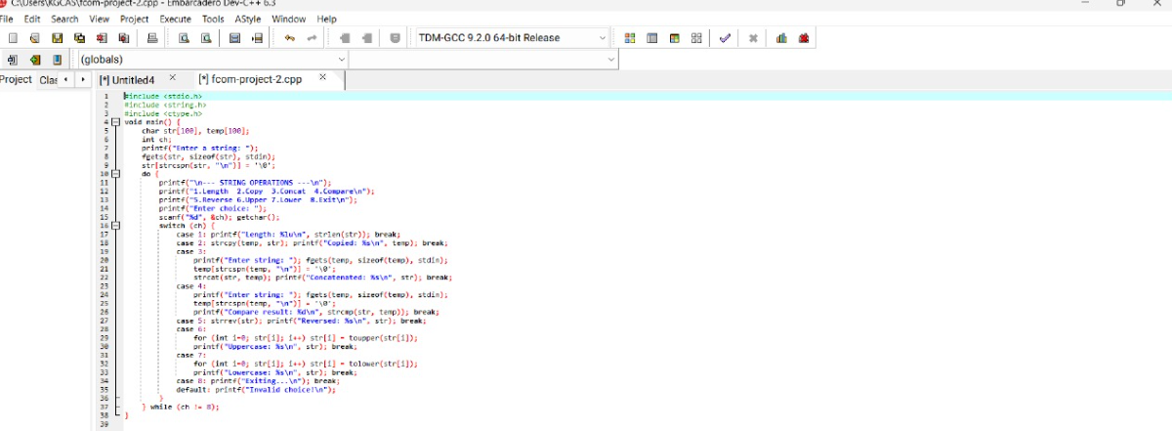
Implementation
C Programming Project Presentation

Slide 10
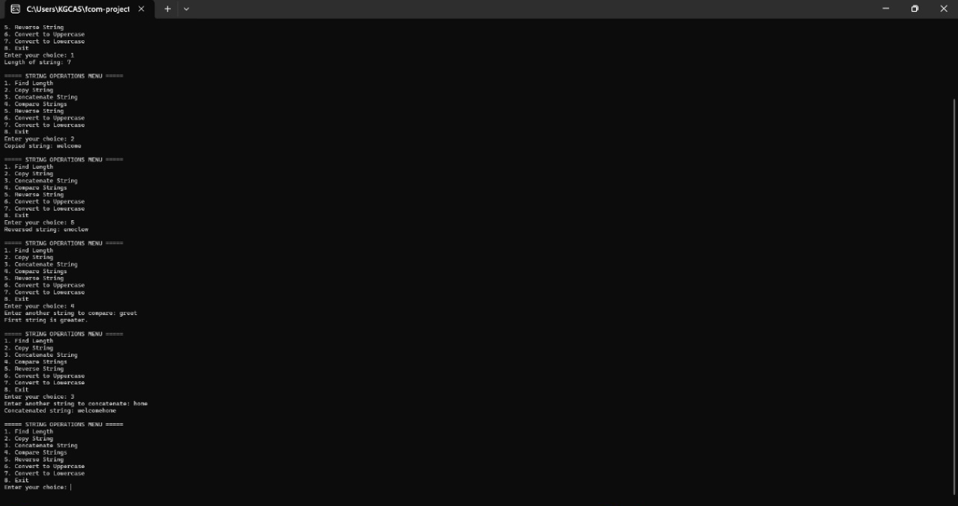
Output Screens
C Programming Project Presentation

Slide 11
Results & Discussion
C Programming Project Presentation
The String Utility Box produced accurate outputs for all string operations such as counting characters, reversing text, and checking palindromes. The results matched the expected outcomes, showing high accuracy and fast performance. Challenges like handling spaces in strings and file errors were resolved using fgets() for input and proper file handling checks, ensuring smooth and reliable execution.

Slide 12
Conclusion & Future Enhancement
C Programming Project Presentation
Conclusion:
The String Utility Box met its goals by automating string operations and improving understanding of C programming and system design.
Future Enhancements:
Future improvements include adding a GUI, integrating a database, and expanding features for better scalability.

Slide 13
References / Acknowledgement
C Programming Project Presentation
References:
Let Us C – Yashavant Kanetkar
C Programming – E. Balagurusamy
Online C resources
Acknowledgement:
Grateful to my mentor, department, and team members for their guidance and support in completing the String Utility Box project.

Slide 14
Thank You
"Simplifying string operations through logic, learning, and innovation."

